Slide 1
Risk Projects

Slide 2
List of Projects
Blaze
Mercury
Apollo
Gemini
R1, R2 (Web)

Slide 3
Blaze
Blaze is a Risk management application to decision all transactions (wucom and TMT). Blaze interfaces with third parties to obtains additional variables on a consumer to make a risk-based decision on the handling of a consumer's registration or transaction.
Blaze is an existing Risk Management Application and enhancements are carried out in various Sprints.
http://jira-digital.wuintranet.net/secure/RapidBoard.jspa?rapidView=11&view=planning&selectedIssue=FRAUDTWO-918

Slide 4
Mercury
Mercury is the next generation Risk management platform. The high level objectives of Mercury are:
Make all internal WU data and 3rd Party data available for analytics and decisioning
Support customizable workflows for decisioning any customer interaction
Support proactive monitoring and reporting
Support rapid model/rule development, testing and deployment
Support ease of data aggregation development, testing and deployment
Support integration, test, deployment and monitoring of 3rd party APIs
Support governance and audit controls
Support 20x transaction volume by 2015

Slide 5
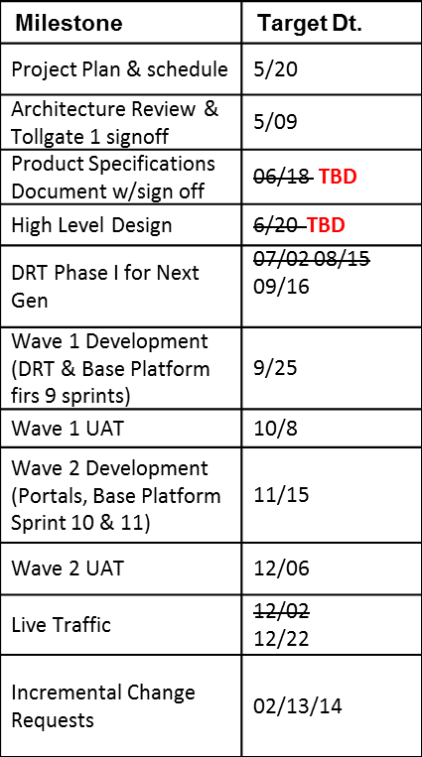
Mercury timelines

Slide 6
Gemini
Gemini is Reporting, Analytics and Big Data Product Engineering for WU Digital.
High level plans for Gemini project this year:
Priority -1 – Stabilize current risk eco-system
Reduce the number of real time calculations of velocities in Blaze in real time from current 600+ to under 100.
What needs to be done to get there – Bring all data from Blaze Warehouse and reporting into Hadoop on an select interval, write a battery of map-reduce functions that can calculate the 500 velocities that were moved away from real time into batch, effect only the scores in real time decisioning
Priority-2 – Develop solutions in Big data that will directly help in short and long term business benefits and meeting our goals around risk approvals through proper modeling/re-scoring
Bring all required data from Blaze into Hadoop so that all retro-calculations of newly created velocities can be done in Hadoop going forward. Will help keep up pace with the current model roadmap
Create a solution that gives us the ability to re-score flagged transactions in an offline manner utilizing data from Blaze and SilverTail (to name a few sources) so that within a window of 2-3 hours we can re-score transactions in Hadoop and then provide a capability in HBase (or whatever solution you decide) for monitoring team to cancel a transaction that has been approved but has not been picked up at the retail location yet

Slide 7
Gemini - Current status
Data Load
Development completed
End to end testing in progress
Incremental data load job set up in progress
Incremental data load will be scheduled to run every day at 12:10am. ETA 8/16

Slide 8
Apollo
Apollo will be the next generation WU Digital Payment processing engine
Project Status:
Apollo platform is ready from Wave I stand point.
Currently waiting on the R2 team & Channel Service .
Apollo Integration testing is in progress. Wave I and Wave II.
Target to go live before Q3 2013.

